Slide 1


Fabric Real-Time Analytics in a Day

Slide 2
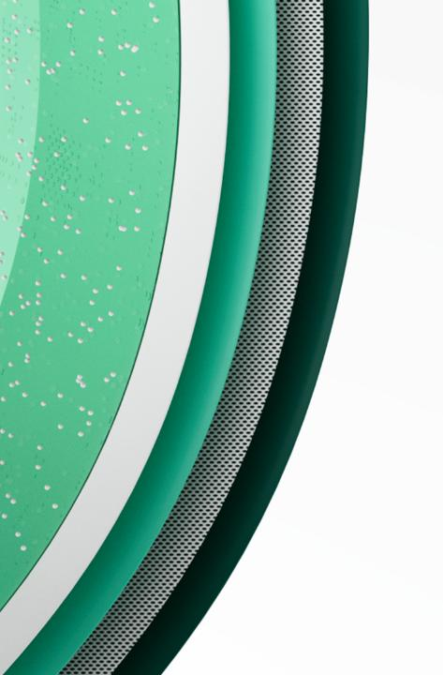
AGENDA
Presentation Part 1
Fabric Introduction
Real Time Analytics Overview
KQL Introduction
Lab 1
KQL Database Creation, Data Ingestion and Exploration
Presentation Part 2
KQL Advanced, Data Science
Lab 2
Advanced KQL, Policies, Visualization
Q&A
Notes:
Approx.
45mins each presentation
2hrs on Lab 1
30mins to 1hr lunch (after Lab 1)
2hrs on Lab 2

Slide 3
1
Presentation Part 1
Notes:
Fabric Introduction
Real Time Analytics Overview
KQL Introduction

Slide 4

Microsoft Fabric
Data analytics for the era of AI
Complete Analytics Platform
Lake Centric and Open
Empower Every Business User
AI Powered
Everything, unified
OneLake
Familiar and intuitive
Copilot accelerated
SaaS-ified
One copy
Built into Microsoft 365
GPT on your data
Secured and governed
Open at every tier
Insight to action
AI-driven insights

Slide 5





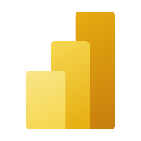

Microsoft Fabric
Microsoft Fabric
An end-to-end analytics platform that brings together all the data and analytics tools that organizations need to go from the data lake to the business user
Single…
Data
Factory
Synapse Data
Engineering
Synapse Data
Science
Synapse Data Warehouse
Synapse Real Time Analytics
Data Activator
Onboarding and trials
Sign-on
Navigation model
UX model
Workspace organization
Collaboration experience
Data Lake
Storage format
Data copy for all engines
Security model
CI/CD
Monitoring hub
Data Hub
Governance & compliance
Power BI
AI Assisted
Shared Workspaces
Universal Compute Capacities
One Security
OneLake
Intelligent data foundation
Notes:
Microsoft Fabric combines Data Factory, Synapse Analytics, Data Explorer, and Power BI into a single, unified experience, on the cloud. The open and governed data lakehouse foundation is a cost-effective and performance-optimized fabric for business intelligence, machine kerning, and AI workloads at any scale. It is the foundation for migrating and modernizing existing analytics solutions, whether this be data appliances or traditional data warehouses.
Talk Track for Greenfield/Growing Analytics Customers – Microsoft Fabric’s SaaS environment makes it easier to deploy an entire end-to-end analytics engine from the ground up at an accelerated pace. With the solution’s built-in security and governance capabilities, you can be rest assured your data and insights are protected.
Talk Track for Existing Synapse Customers – Microsoft Fabric is an evolution of Azure Synapse. You will still be able to enjoy the benefits and limitless scale of Synapse in an easier to use SaaS solution while adopting new capabilities that enhance your entire analytics approach. And with the addition of Power BI, you can help democratize the ability to uncover insights and create interactive reports across the organization, helping everyone make more data-driven decisions in their everyday work.
Talk Track for Existing Power BI Customers – With Microsoft Fabric, you’ll be able to access new and powerful data tools and services like Azure Synapse within the same user experience you already enjoy with Power BI. You can unify these tools with your disparate data sources in the same environment to establish a single source of truth for all data, driving the ability for everyone to uncover more accurate and consistent insights than before. And instead of having to worry about security concerns of a patchwork analytics estate, you can be rest assured your data is protected with the built-in security and governance capabilities.

Slide 6












The world is exploding with
high-granularity data…
How do you turn it into a competitive edge?
Notes:
high granularity = RT + Obs
Becoming faster than your competitors – turn your data into a competitive advantage faster
Data-first applications? Data-first operations?
Understanding phenomena, discovering unknown unknowns (correlations, causations, etc.)
Fine-grained observations (in time, in space) -> timely action

Slide 7

Real-time analytics in Fabric
By-default streaming ingestion
By-default indexing everything
Time and Hash-based data partitioning
Data movement
Torrents of data
Take action on real-time data
Native support for structured, semi-structured and free text data
In-place transformation
Fabric
Real-Time Analytics
Simplicity
SaaS
One unified portfolio for all data and AI solutions
All Experiences are fully integrated
One Logical Copy
Notes:
Introducing Real Time Analytics in Fabric!
Fabric Real-time Analytics solution enables organizations to consume torrents of data, focus and scale up their Analytics solution with data in motion, empower their business analysts, and democratize their data for citizen data scientists and Data Engineers.

Slide 8
Observational Analytics
Frequently changing business questions
Constantly changing schema
Near real time visibility required
Why is it challenging to analyze?
Analytics systems costs are often prohibitive
Looking for unpredictable phenomena
Notes:
High granularity
Low latency

Slide 9
Poll: Do you work with use cases involving analytics on telemetry data?
👍Yes
👎Not yet

Slide 10





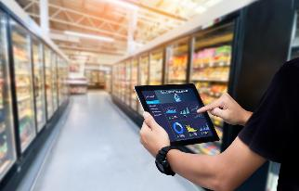



Every Vertical
Manufacturing
Logistics
Energy & Utilities
Automotive
Finance & Insurance
Retail
Telecommunications
Security
Analytics & Software
Notes:
Relevant for all verticals.
The practice of Analyzing high granularity data allows:
Flexibility
Find the unkonws – The new insights (Not the old ones)
No cliff from dashboard to investigation and root cause – “Forenshics”
Low latency
Discover early
Alert
Act

Slide 11


Highlighted industries scenarios
Transportation and logistics
Smart cities/ buildings/home
Manufacturing operation
Automotive industry
Energy oil and gas
IoT Analytics
Log Analytics

Slide 12
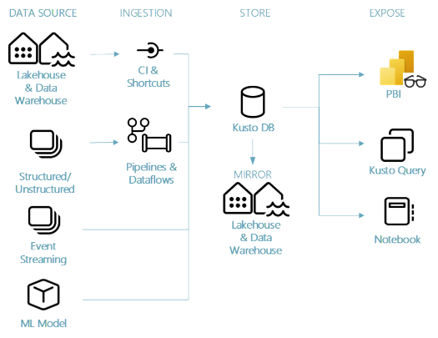
Real-time analytics in Fabric
Common Architecture
Ingestion: Event streaming through Event Hubs/IoT Hub/OneLake/Pipelines & Dataflows/Notebooks/Open-source ecosystem (Kafka, Logstash, Open Telemetry, etc.)
Storage: Kusto DB, and Lakehouse via mirroring
Train and test: ML Models and Experiments
Exposure: Power BI through see-through mode, KQL, Notebook via Spark/KQL, Data Activator detects & alerts.
Data Activator
Notes:
This is a very common architecture,
Data can drive in in many ways from many sources -> into Realtime analytics -> than the user can consume the raw data in many ways to get data in NRT
All different personas can consume the data in NRT from different options, like PBI report, KQL Query set, notebook and more

Slide 13
Demo
Contoso Foods is a leading edible and fresh foods delivery company. Their foods include fresh baked breads and milk products.
Their warehouses are equipped with devices that continuously monitor metrics like temperature and humidity that affect the freshness of the food.
https://aka.ms/VBDFabricRTADemos
01 - RTA Demo E2E – Fundamental
Notes:
01 - RTA Demo E2E – Fundamental.mp4

Slide 14
Fabric Real-Time Analytics (RTA)
Find insights, track progress, and make decisions faster.
KQL Database
Real-Time Dashboards
KQL Queryset
Eventstreams
Power BI
Data Activator

Slide 15
KQL database key capabilities
Any data source
Streaming analytics in NRT
High performance Low latency High freshness
Timeseries database
Everything is indexed and partitioned
Structured Semi-Structured Free-text
Real-time data Transformation of complicated data structure
Unlimited Scale (query, ingestion, storage)
Any data format
Notes:
The key capabilities that makes Realtime analytics the best solution for those scenarios are
The ability to collect different data type from different cloud services, structures, formats into one place in raw format
All data structuered , semi-structuered and text is fully indexed to provided the best solution, run queries on Chat messages with no predefinition

Slide 16
Graph query semantics
Reduced the time to create a new eventstream down to a few seconds.
Introducing Graph Semantics, a new way to contextualize time series data
In-place data sharing
In place, real time, data sharing cross tenant
Create a database shortcut in Real-Time Analytics
Delta table shortcuts
Easily enable querying every delta table in OneLake or Azure Storage
Inline python in KQL database
Easily enable querying every delta table in OneLake or Azure Storage
Vector search for AI embeddings
Leverage the distributed nature of Kusto for high performant embedding selection
Optimizing Vector Similarity Searches at Scale (microsoft.com)
Sample databases
Create new sample databases or consume sample data
KQL Database
recently released

Slide 17
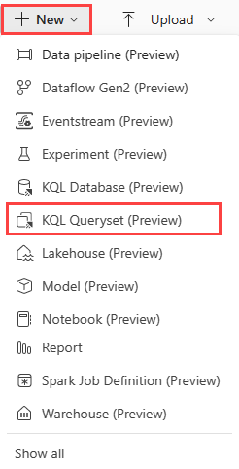
KQL Queryset
Overview
Uses the Kusto Query Language (KQL) for creating queries, views, functions, control commands, customize results and also supports many SQL functions.
Tabs in the KQL queryset can be associated with a different KQL database.
Lets your save queries for later use or share with others to collaborate on data exploration.
You can also change the KQL database associated with any tab, allowing you to run the same query on data in different states.

Slide 18
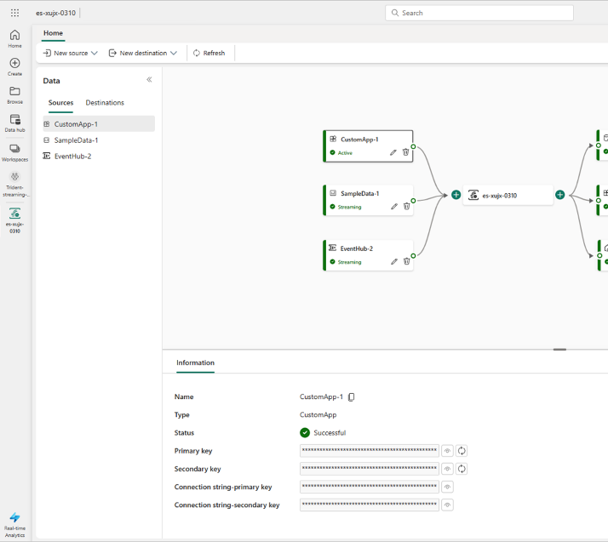
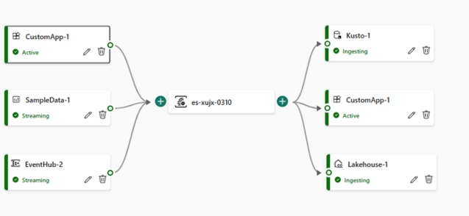
Event Streams
Overview
Centralized place for event data
Capturing, transforming, and routing event data.
Various source connectors
Fetch event data from diverse source, such as Custom Apps to push into eventstreams, Azure Event Hub or Samples.
No-code experience
Drag and drop makes it intuitive and easy to use. Build an end-to-end data flow diagram.
Multiple destinations
Lakehouse, KQL Database, Custom App, Data Activator (Reflex)

Slide 19
IoT Hub Source
Consume events from IoT Hub as a source of events for your eventstream
Stream processing before sending to KQL Database
Users can now do stream processing/transformation on incoming events from event stream before sending the events to the KQL Database that allows you to route, validate, filter, transform or aggregate the events.
AMQP format connection string support
Eventstream now offers support for AMQP format connection strings in both Custom App source and destination, allowing for seamless integration with external message brokers like RabbitMQ with Shovel.
Improved no-code stream processing designer
Improved experiences for editing event streams adding more intuitive gestures in the no-code designer.
Create Eventstream faster
Reduced the time to create a new eventstream down to a few seconds.
Event Streams
recently released

Slide 20
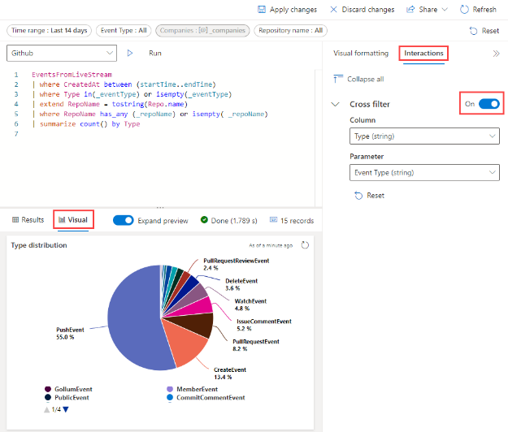
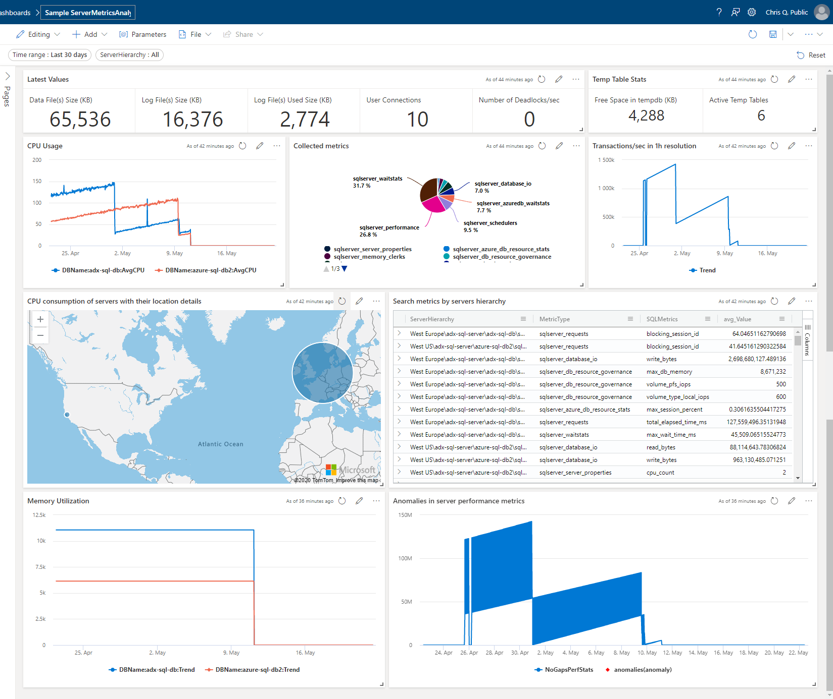
Real-Time Dashboards
Overview
Collection of tiles
Each tile has an underlying query with a visual representation. Can be organized in pages. Supports parameters & cross-filter (drill-through).
Real Time
All live-queries with a min of 30s auto-refresh
Native KQL
Export to dashboard and modify seamless by toggling from analyst to pro-dev or vise-versa.
Visuals
Ease of data exploration. Fully integrated experience, improved query and visual performance with light, flexible modeling on high-granularity low latency data.

Slide 21
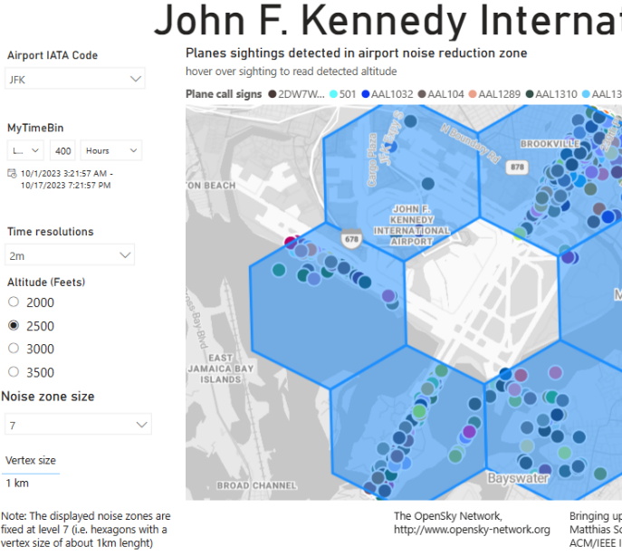
Power BI
Best Practices
Travel light
Bring only the data that you need.
Composite model
Combine aggregated data for top-level dashboards with filtered operational raw data.
Parallelism
Increase concurrent connections in DQ or use weak consistency to improve the performance of dashboard rendering.
Additionally
Use effective slicers, filters and visuals for your data
Notes:
Ref: https://docs.microsoft.com/azure/data-explorer/power-bi-best-practices
https://msit.powerbi.com/groups/3582b164-c42f-4707-98ac-a85e3bf6a734/reports/133eae4e-a933-4bc3-afb5-990ef52d04b3/ReportSection?experience=kusto

Slide 22
Demo
Create Data Activator Triggers from Power BI Reports.
Set an Alert condition & thresholds.
Set an Alert recipient.
https://aka.ms/VBDFabricRTADemos
02 - FabricRTA-DataActivator-PBI-LondonBikes
Notes:
Full length - https://microsoft.sharepoint.com/:v:/t/MPNPartnerEnablementTeam2/EaRYp23ZUkVIuaFn7I53oncBMKh7ES1696cEfLyjDYdicg?e=jlN6xW&nav=eyJyZWZlcnJhbEluZm8iOnsicmVmZXJyYWxBcHAiOiJTdHJlYW1XZWJBcHAiLCJyZWZlcnJhbFZpZXciOiJTaGFyZURpYWxvZyIsInJlZmVycmFsQXBwUGxhdGZvcm0iOiJXZWIiLCJyZWZlcnJhbE1vZGUiOiJ2aWV3In19
Alternates:
https://microsofteur.sharepoint.com/sites/FabricVBD-5-EventsProcessing/Shared%20Documents/Forms/AllItems.aspx?id=%2Fsites%2FFabricVBD%2D5%2DEventsProcessing%2FShared%20Documents%2F5%20%2D%20Real%20Time%20Analytics%2FUpskilling%2FDemos&viewid=485e254c%2D6c33%2D4db3%2D9c8e%2D2f3458dc60dd

Slide 23






Introducing Data Activator
OneLake
Teams
Data Activator
Outlook
Power BI
Synapse Data Warehouse
Power Automate
No-code user experiences
Synapse Real Time Analytics
Custom
Models
Rules
Triggers
…
Real-time stream processing
…
Notes:
Reflex is a system of detection.
It lets your business’s subject-matter experts monitor all of your data in the Microsoft Cloud.
They can use the easy, familiar experiences of Fabric to model that data, define the changing conditions in the data they want to look for
They set up real-time triggers that act on insights.
And Reflex sends notifications, kicks off workflows, or even reaches directly into operational systems to optimize how the business runs
\Sign up for the Data Activator preview : aka.ms/dataActivatorPreview

Slide 24
Demo
Data Activator & Eventstreams using real-time data from an API.
Monitor & Alert based on conditions or thresholds.
https://aka.ms/VBDFabricRTADemos
03 - FabricRTA-DataActivator-LondonBikes
Notes:
Full length - https://microsoft.sharepoint.com/:v:/t/MPNPartnerEnablementTeam2/EaRYp23ZUkVIuaFn7I53oncBMKh7ES1696cEfLyjDYdicg?e=jlN6xW&nav=eyJyZWZlcnJhbEluZm8iOnsicmVmZXJyYWxBcHAiOiJTdHJlYW1XZWJBcHAiLCJyZWZlcnJhbFZpZXciOiJTaGFyZURpYWxvZyIsInJlZmVycmFsQXBwUGxhdGZvcm0iOiJXZWIiLCJyZWZlcnJhbE1vZGUiOiJ2aWV3In19
Alternates:
https://microsofteur.sharepoint.com/sites/FabricVBD-5-EventsProcessing/Shared%20Documents/Forms/AllItems.aspx?id=%2Fsites%2FFabricVBD%2D5%2DEventsProcessing%2FShared%20Documents%2F5%20%2D%20Real%20Time%20Analytics%2FUpskilling%2FDemos&viewid=485e254c%2D6c33%2D4db3%2D9c8e%2D2f3458dc60dd

Slide 25
Resources
Explore the product here: https://aka.ms/try-fabric-rta
Get your questions answered in the Microsoft Fabric webinar series: https://aka.ms/fabric-webinar-series
See the latest announcements in the Microsoft Fabric blog site: https://aka.ms/fabric-tech-blog
Reading the official documentation on Real-Time Analytics: https://aka.ms/fabric-docs-rta

Slide 26
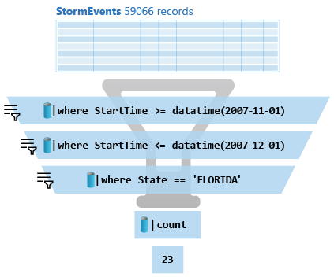
What is a Kusto query?
A Kusto query is a read-only request to process data and return results.
Has one or more query statements and returns data in a tabular or graph format.
Statements are sequenced by a pipe (|). Data flows, or is piped, from one operator to the next.
It's like a funnel, where you start out with an entire data table.
The data is filtered/manipulated at each step and then fed into the following step.
Each time the data passes through another operator, it's filtered, rearranged, or summarized.

Slide 27





KQL Concepts
Relational operators
filters, union, joins, aggregations, …
Each operator consumes tabular input and produces a tabular output
Commands
Can be combined with ‘|’ (pipe)
Similarities
OS shell, Linq, functional SQL…
Agility
Queries are easy to write, read, change
Statements
Single statement query
Use ‘let’ for reusing statements
Multi-statement (‘;’) queries

Slide 28
KQL Basic Operators for data exploration
… | count
Counts records in input table (e.g. T)
… | take 10
Get few records - to familiarize yourself with the data. No actual order ensured.
… | where Timestamp > ago(1) and UserId == 'abdcdef'
Filtering on a specific fields
… | project Col1, Col2, …
Choose some columns (great if input table has dozens of columns)
…| extend NewCol1=Col1+Col2
Introduces new calculated columns
… | render timechart
Render data into a visual plot while exploring

Slide 29
SQL to KQL
Try the ‘EXPLAIN’ operator as follows:
EXPLAIN SELECT COUNT_BIG(*) as C FROM LogisticsTelemetry
Use SQL to KQL Cheat Sheet
Growth mindset 😇

Slide 30
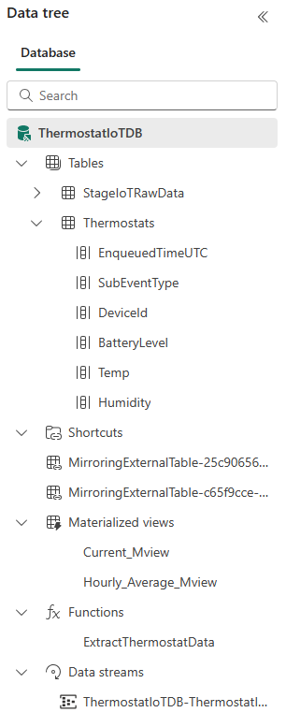
Schema
Schema is
Relational, Lightweight, Dynamic
Databases
Authorization boundary
Transaction boundary
But not query boundary!
Supporting cross-database and cross-cluster queries
Tables
Rectangular
Columns
Supported types: boolean, integer, real, decimal, dates, timespan, string, dynamic (JSON)
Shortcuts (external data)
Stored functions (views)
Materialized views

Slide 31
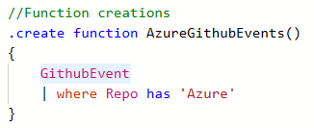
Stored Functions (stored procedures/views)
Functions
Reusable script, defined and used in a Database scope
View
parameter-less function
Schema
Scalar or tabular
Special powers
A function can have the same name as a table
Safe and Secure
Control commands are forbidden.
Applications
Sharing queries between users/applications
Abstracting complex logic from other applications
SQL-compat tools connecting to Kusto via Views to run high-performance queries
Notes:
Learn more: User-defined functions - Azure Data Explorer & Real-Time Analytics | Microsoft Learn
Functions - Azure Data Explorer & Real-Time Analytics | Microsoft Learn .create function command - Azure Data Explorer & Real-Time Analytics | Microsoft Learn

Slide 32
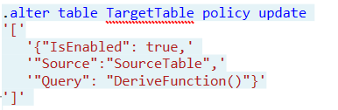
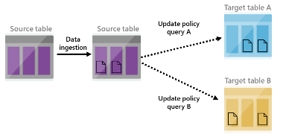
Update Policy (mini-ETL/Trigger)
Essentially
Triggered ingestion into another table.
Semantics
Attached on "target" table and points to "source" table. Transformation is an arbitrary Kusto query
Special powers
Source table is scoped to the newly ingested data only
Applications
Transform data schema (lightweight ETL)
De-multiplexing data stream into several tables
Use target tables with longer retention
Reduce duplicates
Notes:
<Gilles> Update policy is like an internal ETL. It can help you manipulate or enrich the data as it gets ingested into the source table (e.g. extracting JSON into separate columns, creating a new calculated column, joining the new records with a static dimension table that is already in your database, etc). For these cases, using an update policy is a very common and powerful practice. Each time records get ingested into the source table, the update policy's qeury (which we'll define in the update policy) will run on them (and only on newly ingested records - other existing records in the source table aren’t visible to the update policy when it runs), and the results of the query will be appended to the target table.
When you trigger an update policy with a command that adds data to a source table, data also appends to a target table. The target table can have a different schema, retention policy, and other policies from the source table. For example, a high-rate trace source table can contain data formatted as a free-text column. The target table can include specific trace lines, with a well-structured schema generated from a transformation of the source table's free-text data using the parse operator.
Performance impact
Update policies can affect cluster performance, and ingestion for data extents is multiplied by the number of target tables. It's important to optimize the policy-related query. You can test an update policy's performance impact by invoking the policy on already-existing extents, before creating or altering the policy, or on the function used with the query.

Slide 33
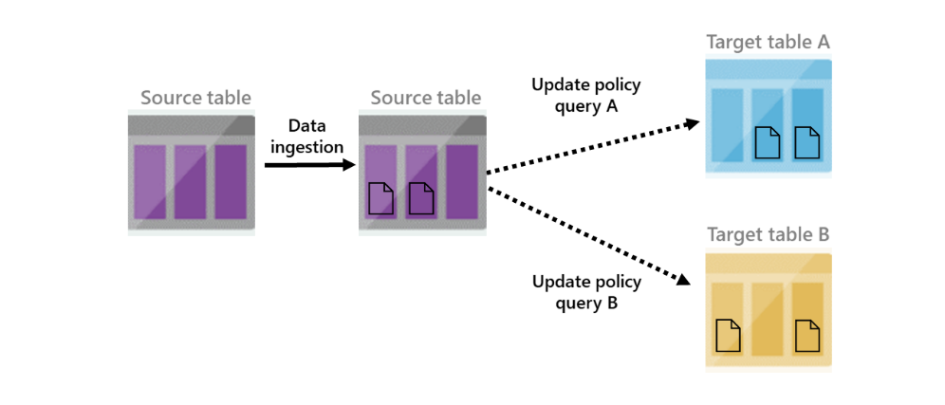
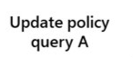

Update Policy
IngestionLogs (244854 records)
ManiputatelogsRaw() filters the newly ingested data
logsRaw
logsRaw + new 3834012 ingested records (not filtered)
Notes:
<Gilles> Source table 'logsRaw' must be referenced in update policy query
Update policy is like an internal ETL. It can help you manipulate or enrich the data as it gets ingested into the source table (e.g. extracting JSON into separate columns, creating a new calculated column, joining the new records with a static dimension table that is already in your database, etc). For these cases, using an update policy is a very common and powerful practice. Each time records get ingested into the source table, the update policy's qeury (which we'll define in the update policy) will run on them (and only on newly ingested records - other existing records in the source table aren’t visible to the update policy when it runs), and the results of the query will be appended to the target table.
When you trigger an update policy with a command that adds data to a source table, data also appends to a target table. The target table can have a different schema, retention policy, and other policies from the source table. For example, a high-rate trace source table can contain data formatted as a free-text column. The target table can include specific trace lines, with a well-structured schema generated from a transformation of the source table's free-text data using the parse operator.
Performance impact
Update policies can affect cluster performance, and ingestion for data extents is multiplied by the number of target tables. It's important to optimize the policy-related query. You can test an update policy's performance impact by invoking the policy on already-existing extents, before creating or altering the policy, or on the function used with the query.

Slide 34
Demo
Real-time geospatial analytics for OpenSky network of aircraft tracker.
Explore data stored in the KQL Database using Kusto Query Language and a medallion architecture.
Functions transform data in real-time and provide semantic views for Power BI reports.
https://aka.ms/VBDFabricRTADemos
04 - RTA Demo E2E - Intermediate

Slide 35
2
Lab 1
KQL Database Creation, Data Ingestion and Exploration
Notes:
Begin Lab 1: KQL Database Creation, Data Ingestion and Exploration

Slide 36
Lab Guidelines
Combination of labs and open-hack. Use the links, hints, try to solve, or raise your hands.
Screenshots are just examples. Your output may not exactly match the screenshots provided.
Please read the instructions carefully.
Badges will be issued within 24 hours.
We will help everyone complete the Labs.
https://aka.ms/FabricRTAinaDay > start with Lab1.md

Slide 37
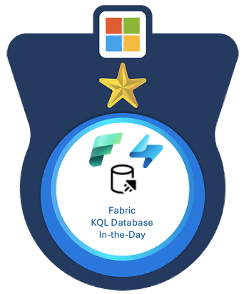
ADX-In-A-Day resources
aka.ms/FabricRTAinADay
Complete the quizzes to earn the badge.
Quizzes can be re-attempted, and will help guide your answers
Lab 1
Lab 2
Lab 1 - Quiz
Lab 2 - Quiz
Notes:
Repo: https://aka.ms/FabricRTAinaDay > Lab1.md > Lab2.md
Lab 1 quiz: https://forms.office.com/r/bV9RCiLVuJ
Lab 2 quiz: https://forms.office.com/r/fpSN0r7QLt

Slide 38
3
Presentation Part 2
Notes:
KQL Advanced
Fabric DS Persona

Slide 39
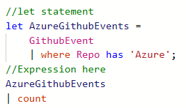
Let statements
Essentially
Named expression or function, defined and used in a query scope
Usage
let foo = T | where … ;
let bar = (val:string) { … };
Schema
Scalar or tabular
Special powers
Can override table / stored function with the same name
Applications
Reusing language expressions
Mid-tier exposing Logical Model (see also: restrict)

Slide 40
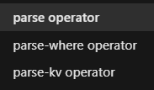
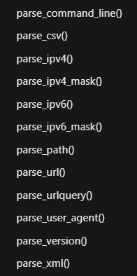
Parsing
Parsing Can be done with regular expressions as well as with native functions for specific data types and patterns
Parsing operators
Return data in columns
Parsing functions
Return dynamic objects using JSON notation
Applications
Parse complex JSON, XML documents
Extract IP addresses, URLs
Extract key-value pairs
Notes:
<Guy>

Slide 41
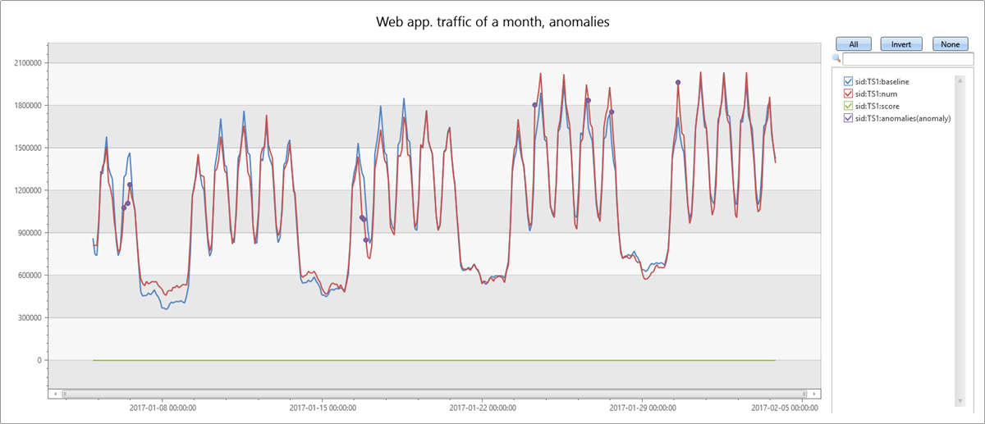
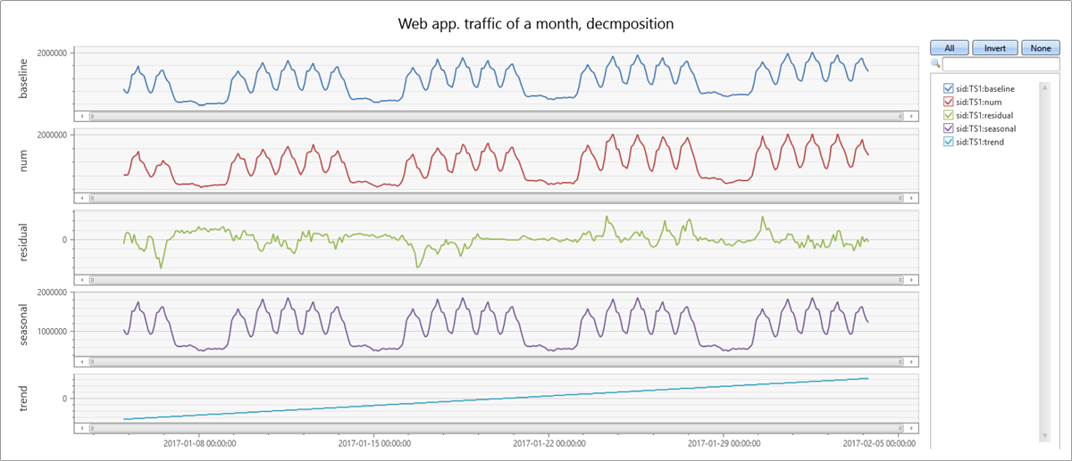
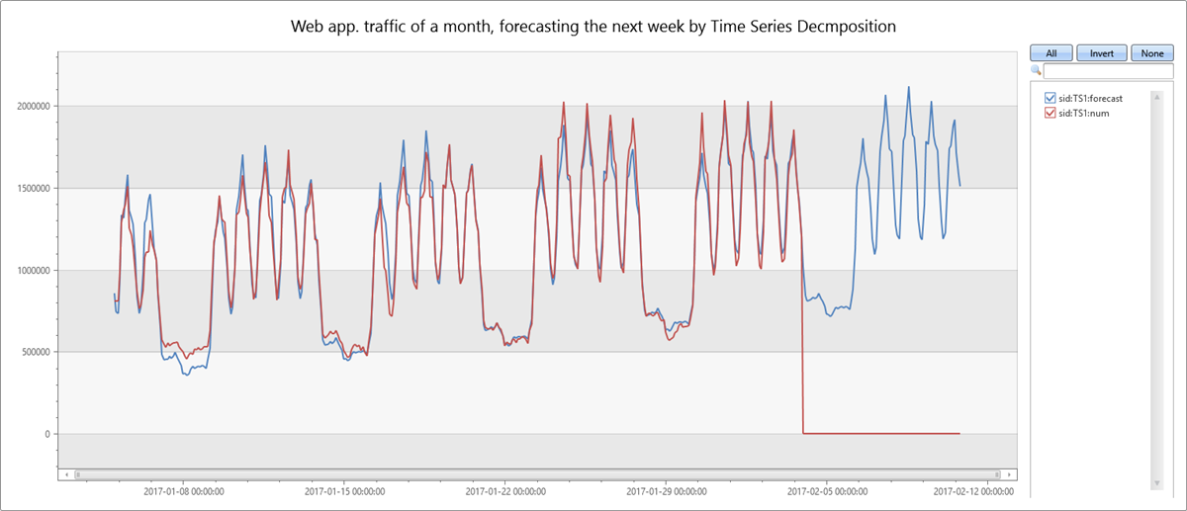
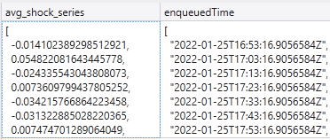
Time Series Analysis
make-series
Operator for creating set of (time) series
Large family of functions can be applied
Element-wise operations
Filtering (signal processing)
Statistics
Regressions
Seasonality detection/validation
Anomaly Detection
Forecasting
mv-apply operator
Optimized for bulks of time series
Notes:
<Hiram>
ADX performs on-going collection of telemetry from cloud services or IoT devices. This data can be analyzed for various insights such as monitoring service health, physical production processes, and usage trends. Analysis is done on time series of selected metrics to find a deviation in the pattern compared to its typical baseline pattern.
From <https://learn.microsoft.com/en-us/azure/data-explorer/kusto/query/time-series-analysis>
simply and intuitively using the make-series operator, and fill-in missing values as needed
Element-wise functions: Arithmetic and logical operations can be done on a time series. Using series_subtract() we can calculate a residual time series, that is, the difference between original raw metric and a smoothed one, and look for anomalies in the residual signal.
Filtering - smoothning a noisy signal, change detection, simple calc of moving average and differentiation. ie. Series_fir(), series_iir(), bins (s/m/d)
Statistics - percentile, standard deviation, mean/min/max/avg/count.
Regressions, segmented linear regression to estimate the trend. series_fit_line() - fit the best line, series_fit_2lines(), detect changes relative to baseline.
Seasonality - auto detect periods/clusters, series_periods_detect(), series_periods_validate() - check if a metric has a specific period and we want to verify they exists.
Anomaly detection - uses series_decompose() and series_outiers() on the residual. Finds seasonal, trend, residual, and baseline. Calculates anomalous points using Tukey's fence test. Control threshold sensitivity. Forecasting is done by extrapolating the seasonal and trend components.
mv-apply operator Applies a subquery to each record, and returns the union of the results of all subqueries. From <https://learn.microsoft.com/en-us/azure/data-explorer/kusto/query/mv-applyoperator>
What is time series analysis?
Time series analysis comprises methods for analyzing time series data in order to extract meaningful statistics and other characteristics of the data. Time series forecasting, for example, is the use of a model to predict future values based on previously observed values.
What is time series decomposition? Time series decomposition involves thinking of a series as a combination of 4 components:
trends (increasing or decreasing value in the series)
seasonality (repeating short-term cycle in the series)
baseline (the predicted value of the series, which is the sum of seasonal and trend components)
noise (The residual random variation in the series). We can use built in functions, that uses time series decomposition to forecast future metric values and/or detect anomalous values.
This is what time series looks like: <click>
Why should you use series instead of the summarize operator ? The summarize operator does not add "null bins"—rows for time bin values for which there's no corresponding row in the table. Advanced built in ML capabilities like anomaly detection, need the data points to be consistently measured at equally spaced intervals, so we have to "pad" the table. The make-series can create such a “complete” series.

Slide 42

Python plugin
KQL extensibility with inline Python
Python engine (sandbox)
Runs on secure local containers on same Kusto engine nodes
Image
Based on Anaconda 5.2.0 + popular packages (tensorflow, keras, torch and more)
Execution
Single node (default) or distributed processing
Extensible
Ability to install custom packages.
Edit & debug in VSCode (client-side integration)
Scalability
Support for scoring with big ML models
Notes:
<Hiram>
DEMO
Here's the KQL script I demo'ed: ADXIoTAnalytics/ADXInADay-DemoML.kql at main · Azure/ADXIoTAnalytics (github.com)
This KQL script includes options and addition ML training guides: ADXIoTAnalytics/M06-Demo5-TrainModel.kql at main · Azure/ADXIoTAnalytics (github.com)

Slide 43
ML Connectivity
Notebooks with Kqlmagic library
Connect multiple clusters (Kusto, Log Analytics, App Insights). Create rich interactive notebook with Kusto and Python. Use out-of-the-box integration with Python libraries.
Python & R Client SDKs
Access data from Kusto using Python or R libraries
Spark connector
Read data or write data to Kusto using Scala and PySpark
Parquet support
Ingest parquet files from Blob/Data Lake. Export data to Blob/Data Lake as parquet files (with partitioning support)
External tables
Query parquet files from data lake as external
Notes:
<Hiram>

Slide 44
4
Lab 2
Advanced KQL, Policies, Visualization

Slide 45
ADX-In-A-Day resources
aka.ms/FabricRTAinADay
Complete the quizzes to earn the badge.
Quizzes can be re-attempted, and will help guide your answers
Lab 1
Lab 2
Lab 1 - Quiz
Lab 2 - Quiz
Notes:
Repo: https://aka.ms/FabricRTAinaDay > Lab1.md > Lab2.md
Lab 1 quiz: https://forms.office.com/r/bV9RCiLVuJ
Lab 2 quiz: https://forms.office.com/r/fpSN0r7QLt
INTERNAL-Only:
Quiz 1 Form:
Quiz 2 Form:

Slide 46
5
Q&A
Open discussion

Slide 47

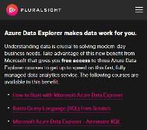
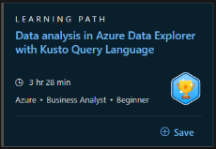
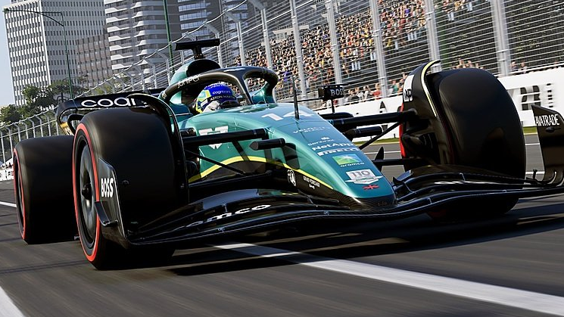


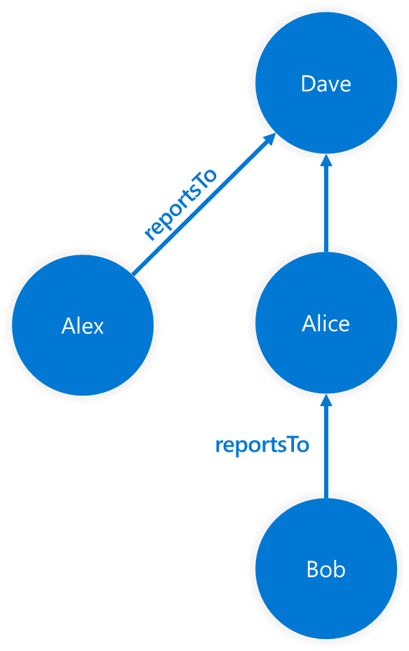
6
Next steps
Continue your learning
L300, L400, POC, Migration, etc
Notes:
L300: Fabric RTA FlightStream – we need volunteers (follow-up more info) already in gearup/seismic link.
* Overview: https://msit.powerbi.com/groups/3582b164-c42f-4707-98ac-a85e3bf6a734/reports/26f780e4-6903-4993-b69c-58c630199533/ReportSection?experience=kusto
* Live Noise Compliant Report: https://msit.powerbi.com/groups/3582b164-c42f-4707-98ac-a85e3bf6a734/reports/133eae4e-a933-4bc3-afb5-990ef52d04b3/ReportSection?experience=kusto
* QuerySet: https://msit.powerbi.com/groups/3582b164-c42f-4707-98ac-a85e3bf6a734/queryworkbenches/2ee5fb5d-2aa7-4232-9ab1-a0e1c06cc9a7?experience=kusto
* Repo: https://github.com/microsoft/Fabric-RTA-FlightStream
L300: ADX Microhack - https://aka.ms/adx.microhack (IoT)
L100-L400: Kusto Detective Agency
* https://aka.ms/KDAHackathon
* https://detective.kusto.io
L300: Book PDF – (https://aka.ms/MustLearnKQL)
L300-400: KQL Graph Operators
https://microsofteur.sharepoint.com/sites/FabricVBD-5-EventsProcessing/Shared%20Documents/Forms/AllItems.aspx?ct=1697672870836&or=Teams%2DHL&ga=1&LOF=1&id=%2Fsites%2FFabricVBD%2D5%2DEventsProcessing%2FShared%20Documents%2F5%20%2D%20Real%20Time%20Analytics%2FUpskilling%2FPresentations&viewid=485e254c%2D6c33%2D4db3%2D9c8e%2D2f3458dc60dd

Slide 48
Thank you

